Slide 1
MODULE A UNIT A3

Slide 2
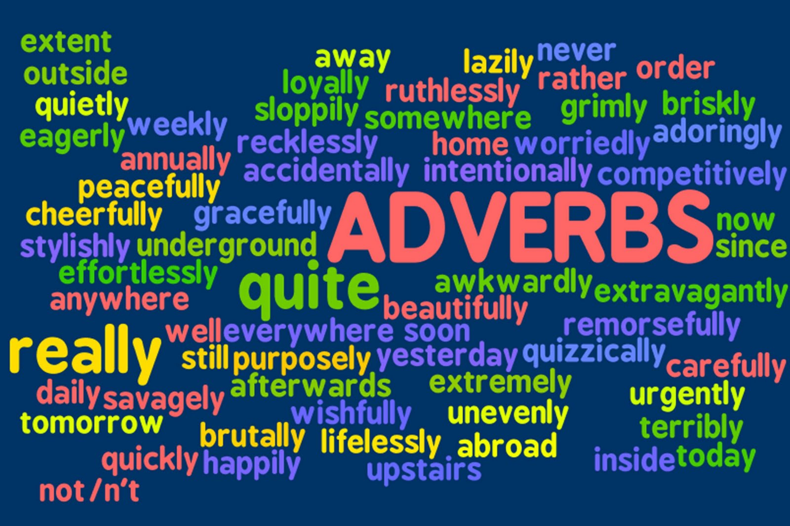

Slide 3
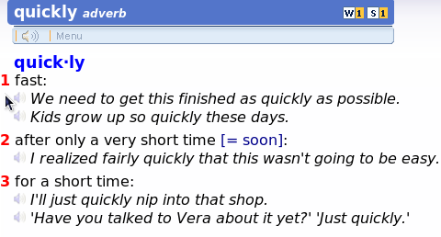
Adverbs
We use adverbs to describe a verb, an adjective or another adverb:
She sings beautifully.
Karen is incredibly intelligent.
They usually go after the verb.
Most adverbs end in –ly.
Some do not end in –ly: well, fast.

Slide 4
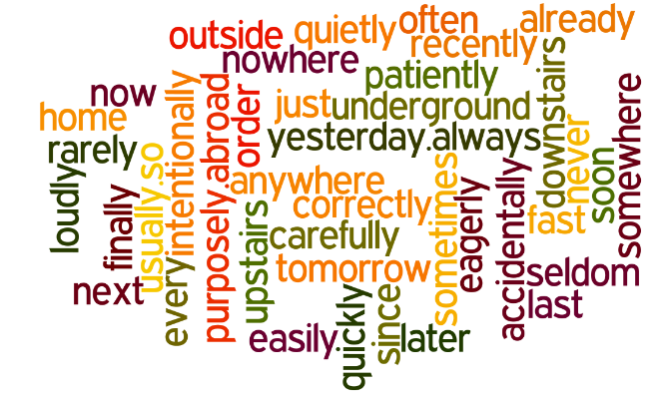
Adverbs give us information about time (when?), place (where?), manner (how?) and frequency (how often?).
Some adverbs are phrases:
He’s arriving on Tuesday, so we’re meeting him at the station.

Slide 5
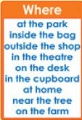
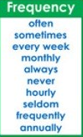
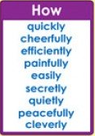
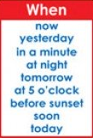

Slide 6
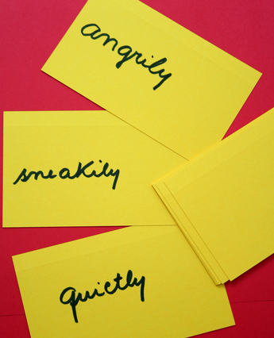
Adverbs of Manner
They describe how something is done.
He eats very healthily.
John writes quickly.
Old people usually drive slowly.
We usually form adverbs of manner by adding –ly to the adjective.
bad – badly
careful – carefully
UTN - FRVM Lic. Evangelina Cecchel - Lic. Bibiana Fernandez

Slide 7

If the adjective ends in –e , take off the –e.
gentle – gently
simple – simply
reasonable - reasonably
If the adjective ends in –y, we usually change the –y to –i.
angry – angrily
easy – easily
happy – happily
healthy – healthily
heavy – heavily
noisy – noisily
But…shy - shyly
UTN - FRVM Lic. Evangelina Cecchel - Lic. Bibiana Fernandez

Slide 8
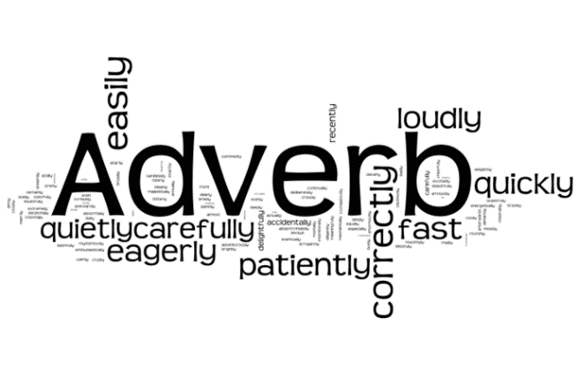
If the adjective ends in –ic, we add –ally.
dramatic – dramatically
tragic – tragically
Some adjectives end in –ly: friendly, lonely, lovely, silly, ugly, deadly, lively …We don’t add –ly to make the adverb. We use: “in a (adverb) way/manner”.
He was talking in a silly way.
They danced in a lively manner.
UTN - FRVM Lic. Evangelina Cecchel - Lic. Bibiana Fernandez

Slide 9
Some adjectives and adverbs have the same form: fast, hard, late, early, daily, weekly, monthly:
Adjectives Adverbs
He caught the fast train. He ran fast to catch the train.
He caught the early train. He always arrives early.
She’s a hard worker. She works hard.
The bus is always late. I arrived home late.
My daily newspaper is 50p. I swim daily.
UTN - FRVM Lic. Evangelina Cecchel - Lic. Bibiana Fernandez

Slide 10
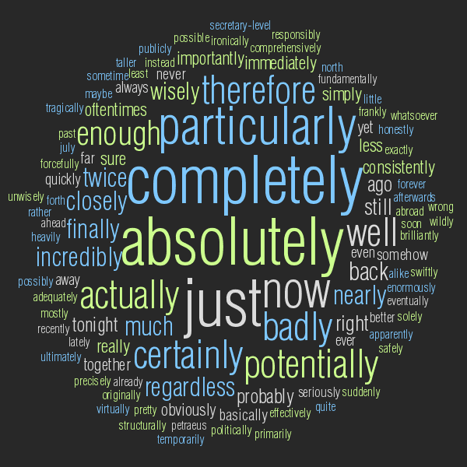
EASILY CONFUSED WORDS
Hard and hardly are both adverbs but they have different meanings. Hardly means “almost not”:
They hardly ever go on holiday. (= almost never)
There was hardly anyone at the cinema. (= almost nobody)
Late and lately are both adverbs but they have different meanings. Lately means “recently”:
I haven’t read any good books lately.
UTN - FRVM Lic. Evangelina Cecchel - Lic. Bibiana Fernandez

Slide 11
CHOOSE THE CORRECT WORD
1. She stepped confident/confidently onto the stage.
2. The meeting at lunchtime was a complete/completely waste of time.
3. She did good/well in the exam and she won a prize.
4. Max tried hard/hardly to make the hotel receptionist understand him, but his Spanish wasn’t fluent/fluently enough.
5.After looking at the computer screen all day I had an awful/awfully headache.
6. Even though Deborah did the job efficient/efficiently, they fired her after two months.
7. The doctor couldn’t understand why Carol felt so hot because her temperature was normal/normally.
8. The boy behaved bad/badly on a school trip.
UTN - FRVM Lic. Evangelina Cecchel - Lic. Bibiana Fernandez

Slide 12
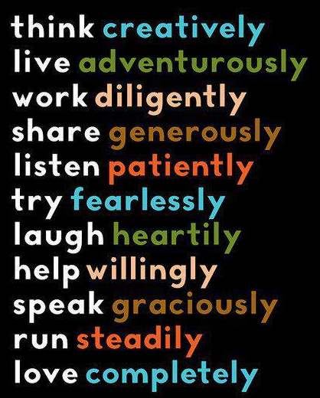
Now relax and enjoy…
UTN - FRVM Lic. Evangelina Cecchel - Lic. Bibiana Fernandez

Slide 13

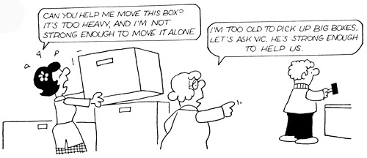
UTN - FRVM Lic. Evangelina Cecchel - Lic. Bibiana Fernandez

Slide 14
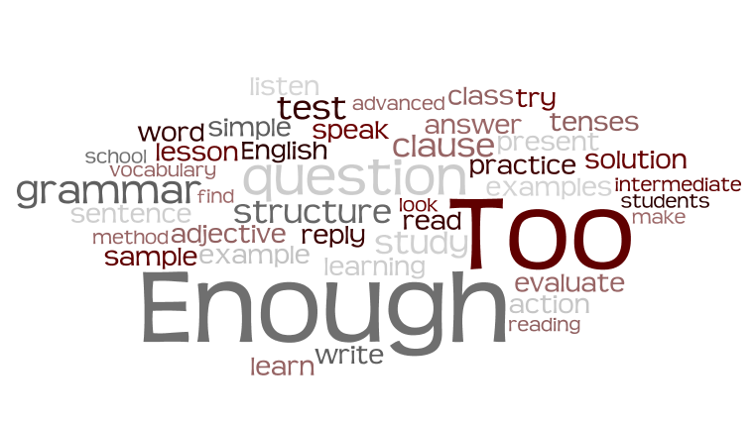
Too means “demasiado” in Spanish, that is more than is needed or wanted.
We generally use this expression to explain why something is impossible.
It’s used before adjectives…
This exercise is too easy. I’m going to do a different one. Mary is too young to get married.
The food is too hot to eat.
UTN - FRVM Lic. Evangelina Cecchel - Lic. Bibiana Fernandez

Slide 15
...or before adverbs.
I don’t check my emails at night. I get home too late.
It was raining too heavily when the accident happened.
He was driving too quickly to avoid the accident.
Mary was doing too well in the course to give up.
UTN - FRVM Lic. Evangelina Cecchel - Lic. Bibiana Fernandez

Slide 16
TOO & ENOUGH
After the adjective or adverb we need to use "to" + the infinitive.
He's too young to drive. It's too early to go to her house.
UTN - FRVM Lic. Evangelina Cecchel - Lic. Bibiana Fernandez

Slide 17
Enough means “lo suficientemente” in Spanish, that is sufficient.
We generally use this expression to explain why something is possible.
It’s used after adjectives…
Ben runs fast enough, he will win the race.
He is strong enough, he can overcome the problem.
She is intelligent enough, she will pass the test.
UTN - FRVM Lic. Evangelina Cecchel - Lic. Bibiana Fernandez

Slide 18
…or after adverbs.
I arrived early enough.
After the adjective or adverb we have to use "to" + the infinitive.
He isn't old enough to drive.
He isn't strong enough to lift it.
UTN - FRVM Lic. Evangelina Cecchel - Lic. Bibiana Fernandez

Slide 19
Complete with the correct option:
a) We are __________ to help you at the moment. Come back later please! (busy)
b) Is your cocktail ___________________? (cold)
c) My sister is _____________ to be a model. Perhaps when she grows up... (young)
d) Don't be silly! You are _________________ for bungee jumping. For God's sake, granddad! You're 89! (old)
e) It’s ___________to take pictures in here. Please, turn on the lights! (dark)
f) The exam was ________________ for the students to pass it. (easy)
g) He won’t get the job because he doesn’t have __________________. (experience)
h) The restaurant was _______________ and the food wasn't very good. We won't come back there. (bad)
i) Let’s take a taxi, it’s ___________________to walk, besides I'm tired! (far)
j) Put on your coat on! It’s not __________________ to go out without one. (warm)
UTN - FRVM Lic. Evangelina Cecchel - Lic. Bibiana Fernandez

Slide 20
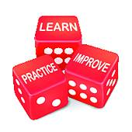
UTN - FRVM Lic. Evangelina Cecchel - Lic. Bibiana Fernandez

Slide 21
Adverbs of time, place, manner and frequency:
http://www.ompersonal.com.ar/omgrammar/adverbios.htm
http://www.agendaweb.org/grammar/adverbs-english.html (time and place)
http://www.englishgrammar.org/adverbs-time-exercise/ (time)
http://www.myenglishpages.com/site_php_files/grammar-exercise-adverbs.php (manner)
https://www.ego4u.com/en/cram-up/grammar/adjectives-adverbs/adverbs/exercises (manner)
http://www.agendaweb.org/grammar/adverbs-exercises.html (frequency)
UTN - FRVM Lic. Evangelina Cecchel - Lic. Bibiana Fernandez

Slide 22
“too” and “enough”:
http://www.ompersonal.com.ar/INTERMEDIATE/unit4/page1.htm
http://www.ompersonal.com.ar/INTERMEDIATE/unit4/page2.htm
http://www.ompersonal.com.ar/INTERMEDIATE/unit4/page3.htm
UTN - FRVM Lic. Evangelina Cecchel - Lic. Bibiana Fernandez

